Slide 1
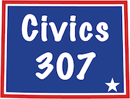
Voter Participation
Primary 2020 & 2022
Gail Symons
30 Jan 2023

Slide 2
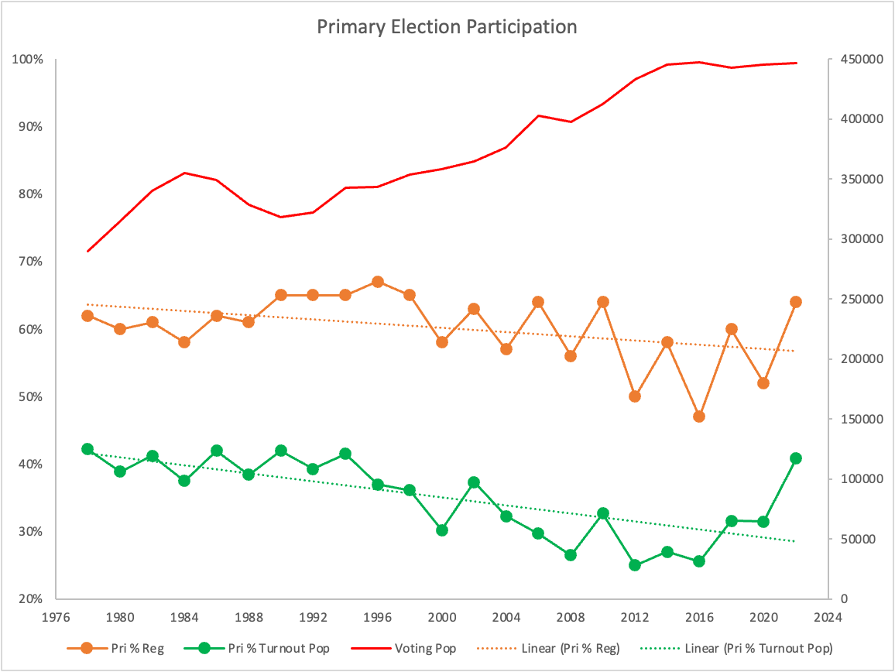
Notes:
Historical participation in Primary Elections
Negative slope
Down in Presidential, up in Top Five
Presidential primary NOT on ballot. Nomination is at GOP state convention with less than 500 delegates. WY Primary occurs AFTER the RNC national convention
Exception in last two cycles

Slide 3
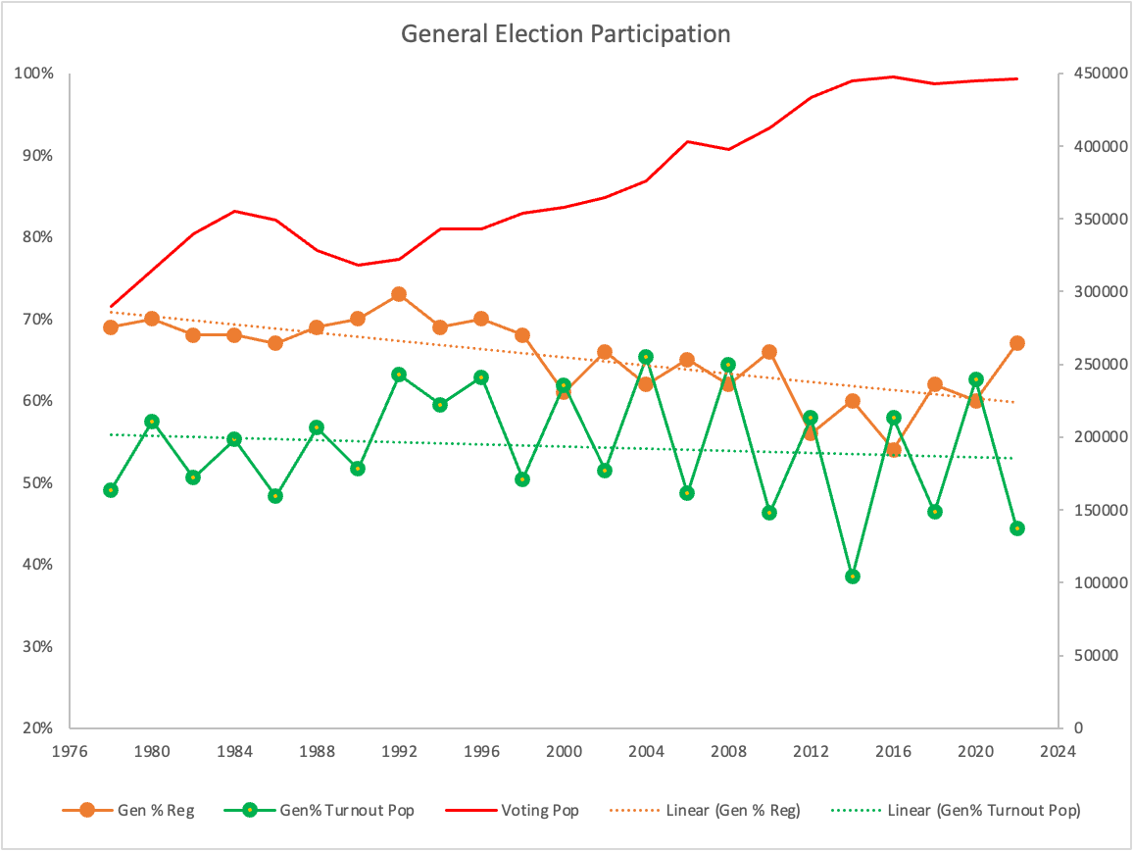
Notes:
Historical participation in General Elections
Greater participation in Presidential cycle than in off years (top five electeds).

Slide 4
Wyoming 2020 Primary Voter Affiliation Changes
1261
3654
Unaffiliated
Republican
3% In
107
105,146
666
1026
37
97
1191
138
19
23571
33
266
All Other
Democrat
8% In
35
From - To
Circle: Actual 2020 Primary Ballot count
From: Any diff 2018 Gen Voter File; 01 Apr 2020 Reg
To: Any diff 2020 Gen Voter File; 01 Jan 2021 Reg
From – To - Return
Notes:
This summarizes the change in affiliation at the individual registered voter over a period of time.
From: affiliation at the 2018 General Election Voter History File and/or the 01 April 2020 Registration (pre-filing period) where the affiliation is different than the Primary election
Bubble: 2020 Primary Election Voter History File affiliations
To: affiliation at the 2020 General Election Voter History File and/or 01 Jan 2021 Registration where the affiliation is different than the Primary election
Takeaways:
1. Greatest change is from Unaffiliated to Republican, 2nd is Republican to Democrat and only the 3rd is Democrat to Republican
Only 293 voters changed BACK. Over 4000 changed and stayed
The increase in Republican was 3% while to Democrats was 8%

Slide 5
Wyoming 2022 Primary Voter Affiliation Changes
6253
Republican
11.7% In
2461
Unaffiliated
169,318
306
531
9,181
191
13
3307
525
339
23
12
9946
281
All Other
Democrat
5.6% In
19
From - To
Circle: Actual 2022 Primary Ballot count
From: Any diff from Jan 2022 Reg
To: Any diff 2022 Gen Voter File
From – To - Return
Notes:
This summarizes the change in affiliation at the individual registered voter over a period of time.
From: affiliation at the 2022 Jan 2020 Registration (pre-filing period) where the affiliation is different than the Primary election
Bubble: 2022 Primary Election Voter History File (received Jan 2023) affiliations
To: affiliation at the 2022 General Election Voter History File where the affiliation is different than the Primary election
Takeaways:
1. Greatest change is from Dem to Republican, 2nd is UAF to Republican and 3rd is Republican to Dem
Only 3886 voters changed BACK. Over 16,914 changed and stayed
The increase in Republican was 11.7% while to Democrats was 5.6%
The number of NEW Republican voters was 49,369. This is new residents, previously registered who have not voted recently and longer term residents registering and voting for the first time.

Slide 6
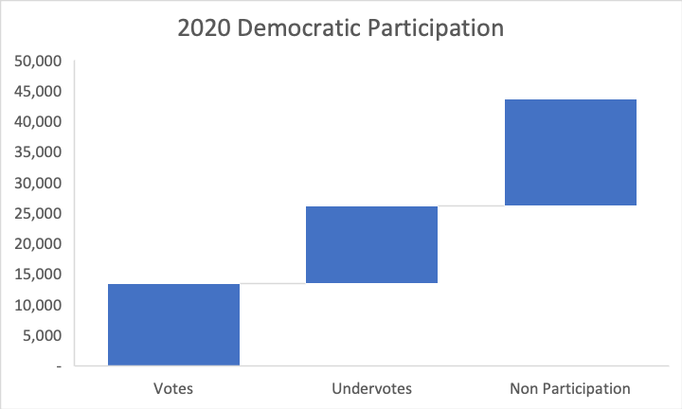
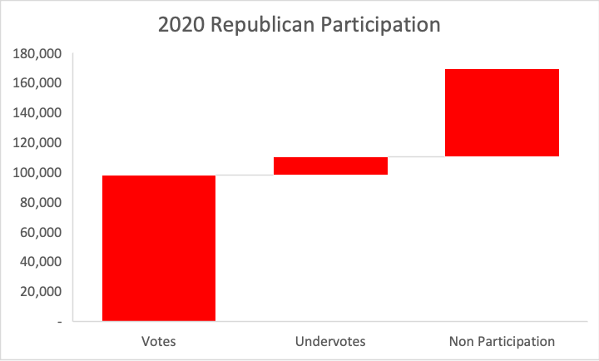
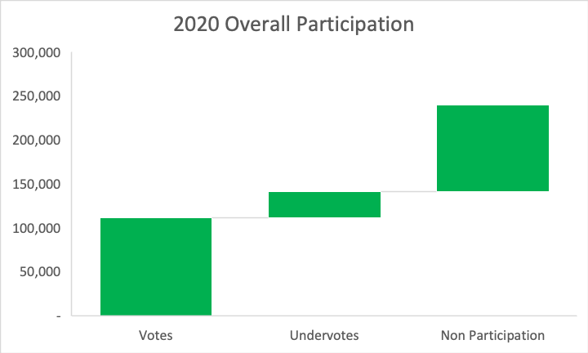
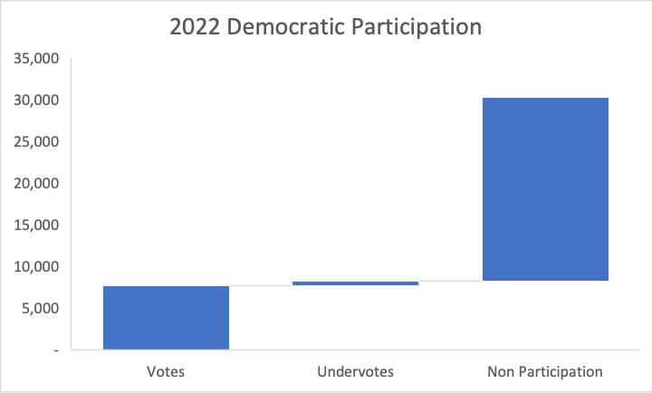
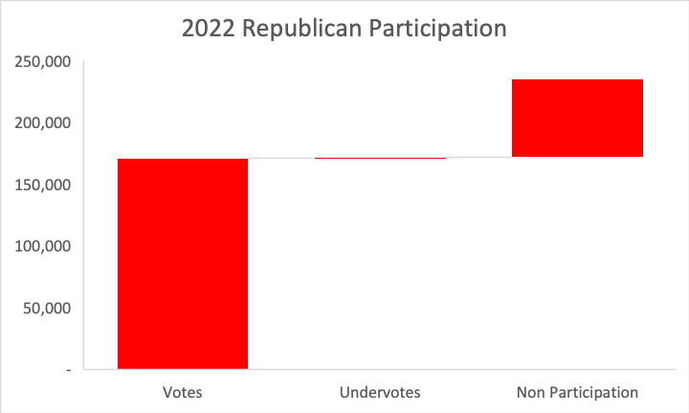
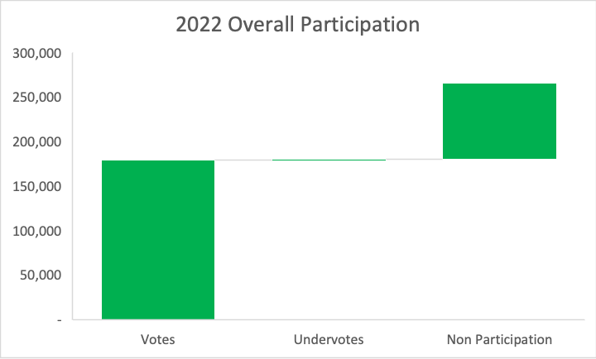
Primary Participation
Walk From Votes to Registration
2020
17,530
58,991
35%
99,215
12,605
40%
97,806
12,644
41%
7%
111,291
28,751
13,485
29%
12%
31%
58%
47%
43,620 Registered
169,468 Registered
239,257 Registered
2022
22,070
63,251
104,782
171,201
846
27%
3,373
35%
178,859
73%
0.4%
1%
7,658
543
73%
61%
25%
2%
30,271 Registered
235,298 Registered
295,198 Registered
Notes:
Comparison of the 2020 Primary to the 2022 Primary by major party and overall.
The total registered comes from the 01 September Registration and 01 December Registration to include same day election registrations.
Undervotes comes from the undervotes for the elected office at the top of the ballot (US Senate in 2020, US Congress in 2022) This is where a ballot has been issued but the voter does not cast a vote.
Non Participation is the difference between number of registrations and the number of ballots issued.
Takeaways:
39% (65,830) increase in Republicans from 2020 to 2022. Anecdotally, this is likely attributed to the significant brouhaha on the Trump/Cheney feud.
The same was reflected in the decrease in percent of non-participation in the major party (35% from 27%) even though the total number increased (56k to 63k)
The amount of increase is greater than the TOTAL number of registered Democrats since January of 2011.
HB0005 has passed that provides for expanded reporting from WYReg for Absentee and Voter Registration. SOS has added VoterID back in but not other non-confidential fields like districts that all more refined analysis at legislative districts, special districts or municipalities
The total number of registered Republicans WHO DID NOT VOTE in the Primary has increased from 57k to 63k.
The solution to pollution is dilution. More Republicans stayed home than total registered Democrats. Get out the vote is a more effective and less controlling response.

Slide 7
What Drives Voting/Crossover?
Republican
Democratic
Office | Under votes | Ballots | % Under |  | Under votes | Ballots | % Under
US Congress | 846 | 172,047 | 0.5% |  | 543 | 8,201 | 6.6%
Governor | 7,626 | 172,047 | 4.4% |  | 964 | 8,201 | 11.8%
Secretary of State | 14,383 | 172,047 | 8.4%
Auditor | 37,255 | 172,047 | 21.7%
Treasurer | 33,043 | 172,047 | 19.2%
Superintendent | 25,472 | 172,047 | 14.8% |  | 1,400 | 8,201 | 17.1%
Senate | 12,710 | 84,070 | 15.1% |  | 232 | 1,796 | 12.9%
House | 25,085 | 172,038 | 14.6% |  | 378 | 3,530 | 10.7%
Republican Precinct Participation
Year | Filed Votes | Write-Ins | Total | Available votes | Under votes | Under %
2020 | 151,377 | 4,923 | 156,097 | 373,043 | 21,575 | 41.8%
2022 | 458,828 | 9,943 | 462,033 | 1,221,476 | 488,163 | 37.8%
Notes:
1. The feud for our US Congress seat drove both increased crossover and increased registration
2. Interest quickly decreased down ticket, even for top five
Increased competition but still low participation in Republican Precincts
Precinct positions available increased as well
300% increase in filed votes at Precinct level but only 4 points higher in participation
Most WY Republicans are not interested in the State Republican Party

Slide 8
Major Takeaways
Voting driven by Candidate interest, not Partisan shenanigans
(Person not Party)
Shutting down crossover will cause permanent change in affiliation
The only way to eliminate crossover/eliminate non-Republicans from nomination process is remove the incentive
- Nomination by Caucus with Qualifying Primaries
If determined to enact restrictions:
blackout period from distribution of Primary absentee ballots through distribution of General absentee ballots
OR blackout 14 days prior to Primary election
Notes:
DELETE all language that restricts one of the most basic rights which is to VOTE. This FEAR is based that someone would be so motivated to both unregister and then re-register to get around the restriction.
REALITY is they would just change early and stay there.

